Slide 1

Setting Direction for VSA Products
Mission & Vision, Product Portfolio, KPIs, OKRs, and Roadmaps
Last updated: October 31, 2019

Slide 2
VSA’s Mission
Guideposts
Enable Veterans and their caregivers to easily discover, apply for, track, and manage their benefits in one place.
VSA’s Mission
Notes:
Is this statement representative of *VSA*?
Are we just interested in benefits e.g. Facility Locator?
rationale - a product like facility locator helps Veterans discover and make use of their benefits
We might ask ourselves what it looks like for any VSA product suite to be successful across discover, apply, track, manage
but if we ask ourselves this question alone, do we lose a cohesiveness around VSA as a whole?

Slide 3
VSA’s Vision
Guideposts
An experience that meets all VA.gov users’ expectations consistent with those of the private sector.
VSA’s Mission

Slide 4
VSA’s North Star
Guideposts
WIP
VSA’s Mission

Slide 5
Who we are

Slide 6
VSA Product Suites and Teams
VSA Product Management
Veteran-facing Services Applications (VSA)
Unauthenticated Experience Products
Authenticated Experience Products
Health Products
Benefits & Memorial Products
Public Websites
Authenticated Experience
Benefits & Memorials 1
Facility Locator
eBenefits
VA Medical Centers
Benefits & Memorials 2
Notes:
*Level-set*
We want to provide clarity on direction for each product team. This includes current/future priorities as well as introducing new teams to the structure.
“A collection of apps and less a cohesive service”
Q: How do we refer to these concepts/organizations? Product teams? Portfolio?
Q: How are new “teams” introduced/on-boarded to this portfolio?
Learned how we’re organized - a portfolio of products within 4 verticals
Start/reference DEPO structure and drill into VSA

Slide 7
Roadmaps

Slide 8
Authenticated Experience
VSA Product Management
Help users accomplish tasks more easily by leveraging what we know about them as a logged in user.
Now
Next
Later
Discovery
Personalization 2.0
Design
Start Personalization 2.0 updates
Build and Launch
HCA Updates
Discovery
Notifications V2
Design
Finish Personalization 2.0 updates
Build and Launch
Direct Deposit
Notification MVP
Address Validation & Bad Address Indicator
Personalization 2.0 (TBD)
Contact Info Update Prompt
eBenefits Migration
Continued Notification Strategy
Content Authenticated Experiences
Forms
Claims & Appeals Status
Pre-Fill expansion
Update to New Page Grid Templates
Continued Personalization 2.0

Slide 9
eBenefits
VSA Product Management
Help Veterans, their dependents, and caregivers get the benefits they've earned by transforming, migrating, and optimizing critical features and functions from eBenefits to the VA.gov central location.
Now
Next
Later
View Rated Disabilities
View Compensation Payment History
View Dependents
View Representative/ POA
View Roles and Relationships
Login User Roles and Relationships
Apply for or Modify Dependency Benefits
Find a Representative for VA Claims
Order Hearing Aid Batteries
Order Prosthetic Socks
Apply for VA Home Loan Certificate of Eligibility
View Post 9/11 GI Bill Enrollment Status
View Education Payments History
Update Direct Deposit and Contact Information for Post 9/11 GI Bill Education
Specially Adapted Housing Grant Application and Claim Status
Claim Status
View Open Applications
Claim Status
View Ancillary Benefits
View My Documents
Request a Representative
Vocational Rehabilitation Benefits & Counseling
Download VA Letters - NonVet Dependent Summary
Exam Appointments Calendar
Servicemembers' Group Life Insurance (SGLI)

Slide 10
Public Websites
VSA Product Management
Help users ﬁnd what they need by serving as the single source of truth for Veterans and their family members.
Now
Next
Later
Discovery
Tier 2 Content audit / Analysis
On-site search for VA.gov
Google Markup Pilot
Establish KPIs / analytics
Build/Launch/Publish
Retirement of explore.VA.gov redirects
Style Guide
Drupal Training
Updates to community care facility locator (urgent care, performance)
Research/Design
Search landing page template
VA forms
IA/ Menu/ Navigation structure
Discovery
Tier 3 Content audit / Analysis
VA.gov Sitewide Analytics
Analyze Google Markup Pilot Results
Build/Launch/Publish
Tier 2/Tier 3 content templates
IA / Menu / Navigation
On-site search for VA.gov
VA forms templates
Schema.org Pilot
VAMC Sites / Pages
Refine established KPIs
Notes:
Inputs
Product Portfolio for Global UX & Content
Already prioritized items
DSVA
How do we measure success
Engagement

Slide 11
Benefits & Memorials 1
VSA Product Management
Help users seamlessly manage their benefits online.
Now
Next
Later
Form 526 – Disability Compensation
Original Claim
Benefit Delivery at Discharge (BDD) Claims
Decision Review
Higher Level Review (Pilot)
EVSS Integration Hardening
Migration of Letters from eBenefits to va.gov
Decision Review
Supplemental Claim
Board Appeal
Form 526 Enhancements
Improvements
V1 migration
Veteran’s disability identification
DD214 Discharge papers
Claim forms from 526 flow
Burial benefits
Notes:
Original Claim - removing wizard where a Veteran may file a claim.
Problem: can’t currently start this on va.gov. _can_ start it on eBenefits.
BDD - allow claim submission via va.gov
Problem: Active Duty nearing discharge are prevented from submitting a claim via Va.gov and are directed to eBenefits
Decision Review - an appeal on a particular decision regarding a claim
Problem: no ability to submit a personalized decision review on va.gov
EVSS integration hardening - ____
Problem:
Migration of Letters from eBenefits to va.gov - ____
Problem: move letters onto va.gov
Decision Review part 2
Supplemental Claim
Board Appeal
Form 526 enhancements
Veteran’s disability identification - New condition autofill algorithm
Problem: when indicating a particular disability, not limiting the Veteran to _______
DD214 Discharge papers - certificate for eligibility for education benefits
Problem: _____
Claim forms from 526 flow -
Problem: prioritizing next forms to integrate into Va.gov
Burial benefits - requesting reimbursement for burial
Problem: allow Veteran or family to submit a claim for burial benefit

Slide 12
How we measure success

Slide 13
Modeling the experience
VSA Product Management
Enable Veterans and their caregivers to easily discover, apply for, track, and manage their benefits in one place.
Discover
Apply
Track
Manage
Notes:
We also learned that success is determined by our ability.
“just moving stuff left to right”
“we want to get to is where we can improve the respective vertical’s health along the 4 dimensions: discover, apply, track, manage”
“how are we currently setting priorities?” e.g. Authenticated Experience’s roadmap
What does success look like (in terms of outcomes/objectives) for VSA as a whole under each of these categories?

Slide 14
Modeling the experience
VSA Product Management
Enable Veterans and their caregivers to easily discover, apply for, track, and manage their benefits in one place.
Discover
Apply
Track
Manage
Unauthenticated Experience
Authenticated Experience
Health
Benefits & Memorials
Notes:
How might we drive priorities for each product vertical?

Slide 15
VSA Product KPIs
Measuring Success
TBD

Slide 16
VSA Product OKRs
Measuring Success
TBD

Slide 17
VSA Product Roadmap
Roadmap
TBD

Slide 18
Appendix

Slide 19
VSA Product Management
Purpose
Guideposts
Product Suite
Measuring Success
Roadmap

Slide 20
VSA Program
VSA Product Management
Mission: Enable Veterans to easily discover, apply for, track, and manage their benefits in one place.
VSA’s most meaningful outcomes (Spans DSVA, VA IT)
Experience that meets all VA.gov users’ expectations consistent with those of the private sector
Enable self-service interactions with VA services where appropriate while being considerate of offline experience/preferences
Make it easier for Veterans and their families to discover applicable benefits
e.g. signing up for VA Healthcare starting with verifying eligibility and going thru to adjudication/decision
Discovery, Right thing, Workflow, Communication
VSA’s most important measurement - how do we know when we’re doing things right?
Working through what’s most useful starting with Customer Satisfaction
Enabled in part thru Foresee
Balancing Time to service vs making their progress more visible
Example: reducing application workload thru visibility into already submitted applications → prevents duplicative submissions
Example: Pension/Burials → making submissions more useful e.g. by sending structured data opposed to documents like PDFs. Idea is the structured data makes back-office processing more efficient
Example: Unauth Exp → survey to find did you find the information you sought today
What’s a metric that can be applied to any VFS team?

Slide 21
VSA Product Suites
VSA Product Management
How do these teams enable VSA’s outcomes? What should each VSA Product Team get right?
Unauthenticated Experience
Global UX & Content
Are users able to find the information they need? [Discover]
Facility Locator (to be)
Are you able to find the facility/health service you’re looking for?
Authenticated Experience
Authenticated Experience (may be differentiated)
Are you confident VA knows who you are and what you care about (reflected back to you)?
Is VA tailoring their digital experience to who the Veteran is and what they need?
Defer to Lisa K.
Health Products
Providing access to the right health service for the person’s need [Right care + Communication + Workflow]
Regardless of the mode
Caregiver
Helping caregivers apply for and get access to caregiver benefits
Benefits and Memorials Products
Providing access to the right benefits for the Veterans’ situation and needs
eBenefits
Disability, Benefits, & Memorials
Disability & Appeals
“Benefits 2” - Pension & Burials (to be)

Slide 22
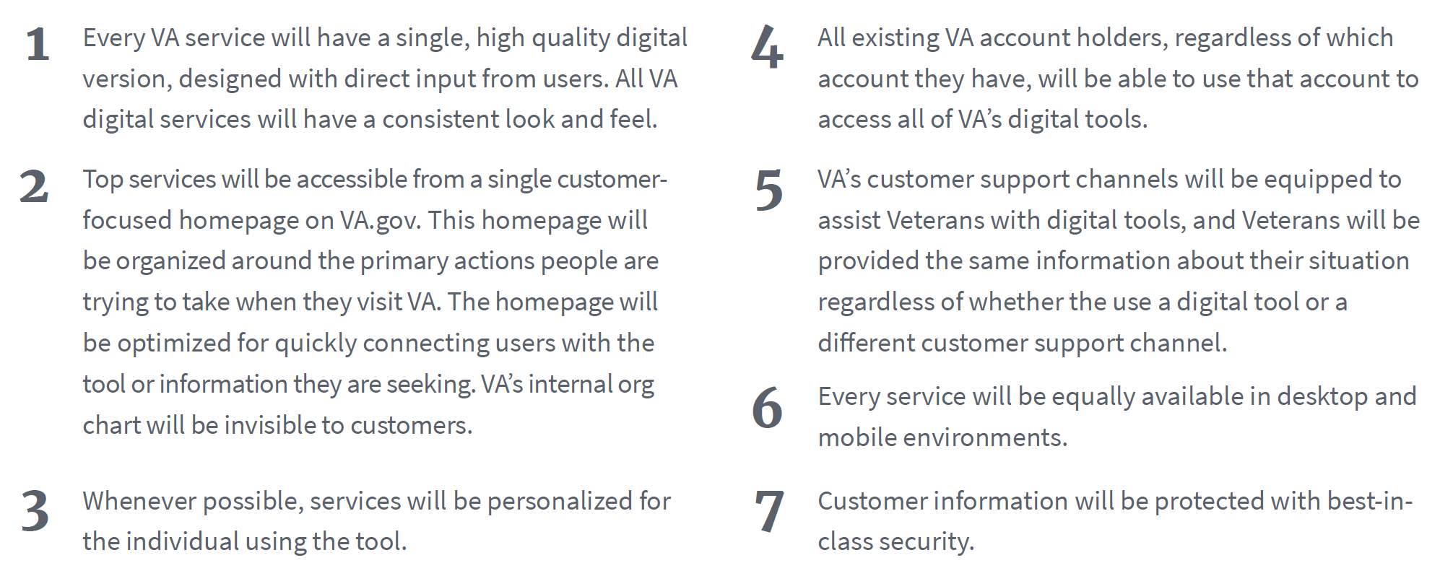
Digital Modernization Principles
Guideposts
VSA’s Mission

Slide 23
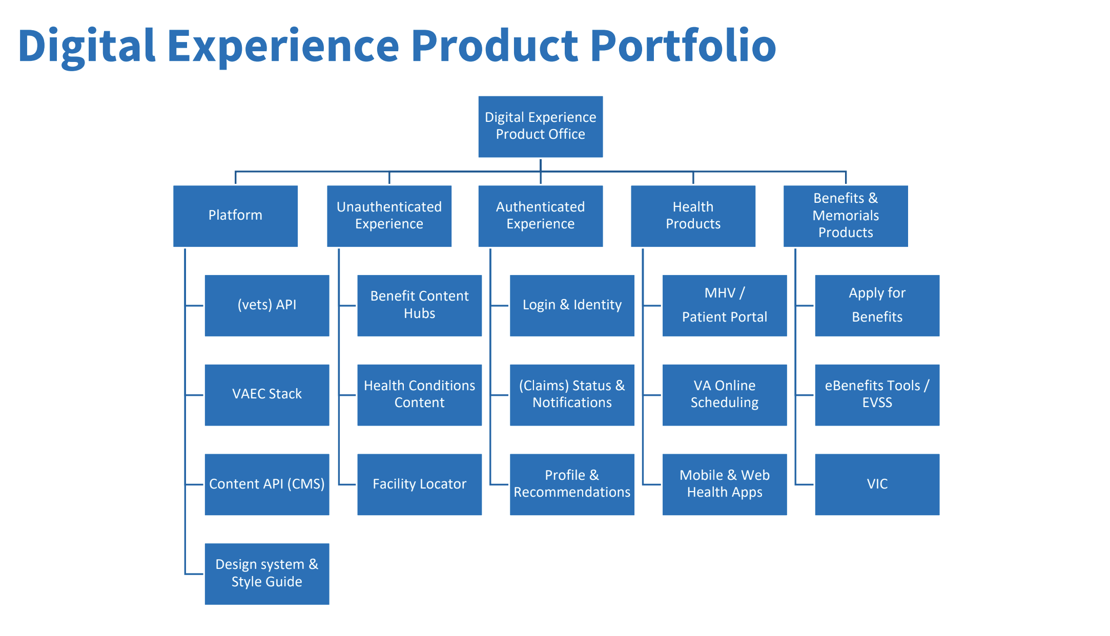

Slide 24
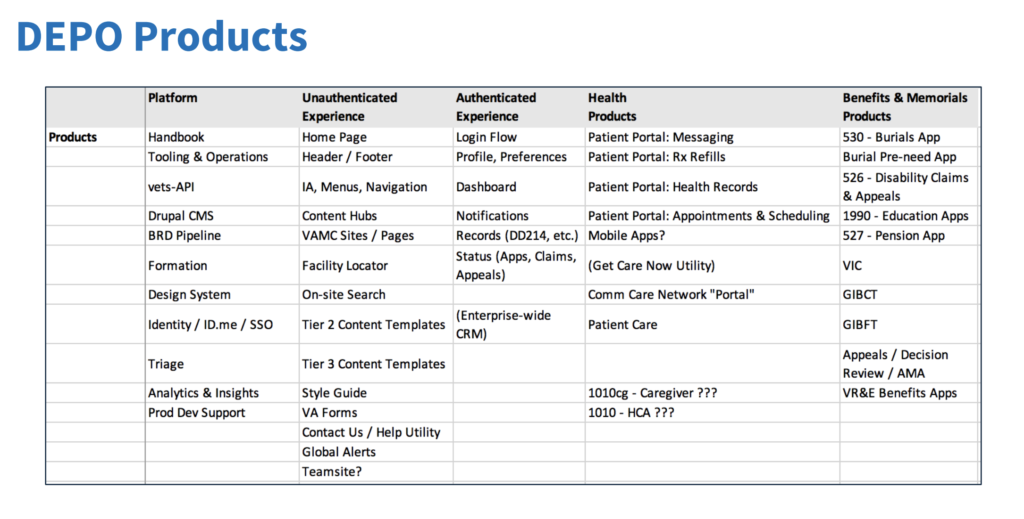

Slide 25
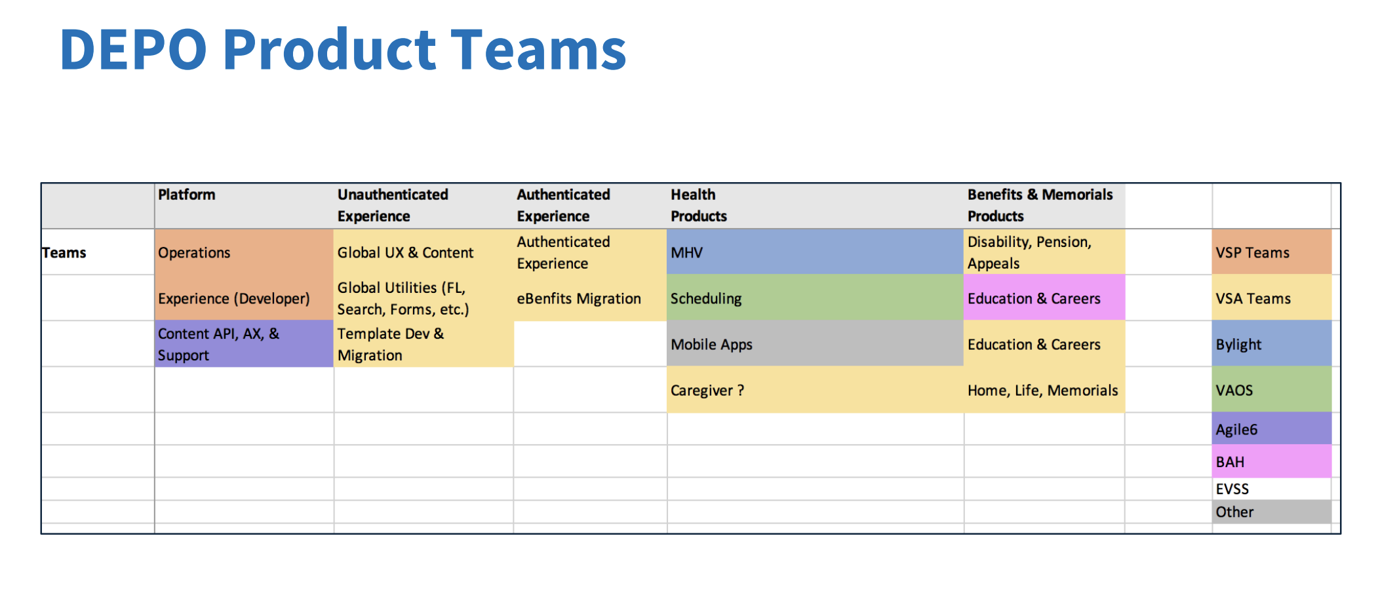

Slide 26
Now
Next
Later
Outcome
Outcome
Outcome
Outcome
Outcome
Outcome
Outcome

Slide 27
VSA Product Team Portfolio
VSA Product Management
Global UX & Content
Authenticated Experience
Caregiver
Benefits & Memorials 1
Home Page
Header / Footer
IA, Menus, Navigation
Content Hubs
Legacy content rewriting
Content Migration (Github to Drupal)
VAMC Sites / Pages
Facility Locator
On-site Search
Tier 2 content templates
Tier 3 content templates
Style Guide
VA Forms
Contact Us/ Help Utility
Global Alerts
Dashboard
Profile
Account
Notifications
Login Flows
In Content Personalization
Form 10-10CG
526 - Disability Claims and Appeals
Appeals / Decision Review / AMA
530 - Burials App
Burial Pre-need App
1990 - Education Apps
527 Pension App
GIBCT
GIBFT
VR&E Benefits Apps
eBenefits
eBenefits Product Migration
Notes:
Important to understand what’s currently in our portfolio
So we can determine how best to prioritize the outcomes for the 4 verticals.
https://docs.google.com/spreadsheets/d/1hzz6whEGoQJQbiNvIggirhydYYdv57nfOZfLvFqZ1pQ/edit#gid=1535759874
How are we currently setting prioritization for the respective teams?
Are those aligned with our mission, vision?

Slide 28
What, Why, How

